Slide 1
LDS Callings
Go to HTTPS://www.ldscallings.com
Click on “Create your Account Now”

Slide 2
New Account
Complete the information requested
Ensure you select “Stake” or “Ward” under “Type”

Slide 3
New Account
Select the country from the drop down menu
Type in a custom name for the site (example test1ward)
Note: The site should only consist of letters and numbers, with no spaces.

Slide 4
Log In
Once your account has been created go to ldscallings.com
Click “Log in” and enter your user name and password

Slide 5
Site Administration
After you log in you will be at the “Dashboard”
Click on Manage People or select "People" and add your Bishopric, Exec Sec, and Clerk/s

Slide 6
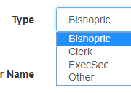
Manage People
Click Add Person
Fill in the information for your Bishopric, Clerks and ExecSec.
Under “Type” “Other” You can add your Ward Council Members if you want them to see the status of the callings they submit or recommend.

Slide 7
Permissions
For each individual you give them permissions based on their callings
You should only select one side or the other (not both)
Left side should be used for those whom submit callings requests or are assigned to call someone but need approval before calling them. (example EQ Secretary, teachers etc…)
Right side permissions are used for Bishopric, Clerks and ExSec)

Slide 8
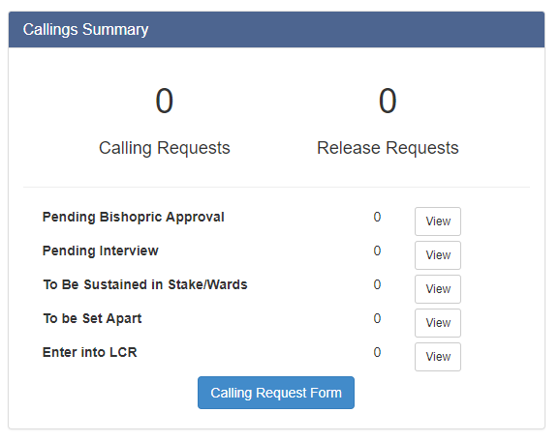
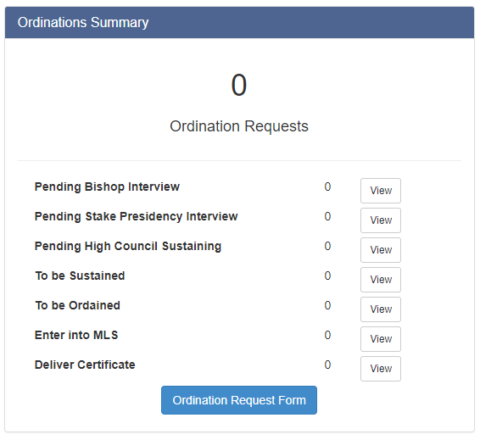
Dashboard
The Dashboard gives you a quick overview of the status of all the callings and Ordinations

Slide 9
Calling and Priesthood Ordinations
To submit a calling or Priesthood Ordination request you can do one of the following:
From the dashboard:
Under the Callings Summary select Calling Request Form and under the Ordinations Summary select Ordination Request Form
Or go to your direct link you created (Example mytestward.ldscallings.com) and select Calling or Ordination form

Slide 10
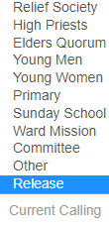
Calling Form
On the Calling/Release Request select the organization the calling is for (Relief Society, EQ etc…) if this is to release someone from a calling select Release from the drop down menu under
Fill in the rest of the information and submit the form.

Slide 11
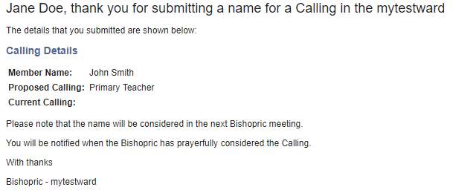
Calling Form
After the request is submitted an email will be sent to the requester and the Bishopric notifying them.

Slide 12
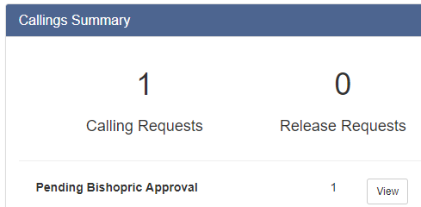
Managing Callings
From the Dashboard you will see the status of the callings
When a calling is submitted you will see it under “Pending Bishopric Approval”
Select view to start managing the callings

Slide 13
Managing Callings
Select Manage under the Action tab
After the Bishop/Branch President considers the request, you select the decision “Approved or Not Approved”

Slide 14
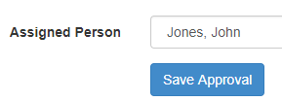
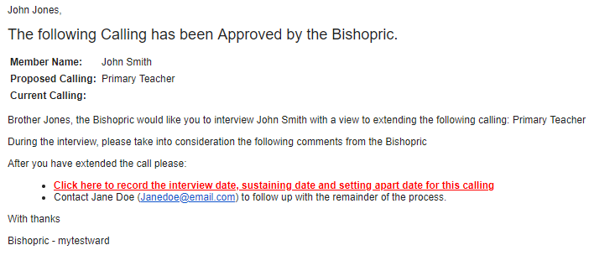
Managing Callings
If the Bishop/Branch President approves the request, you assign the person that will interview and extend the calling and Save the Approval. An email will be sent to the individual notifying them to interview and extend the calling.

Slide 15
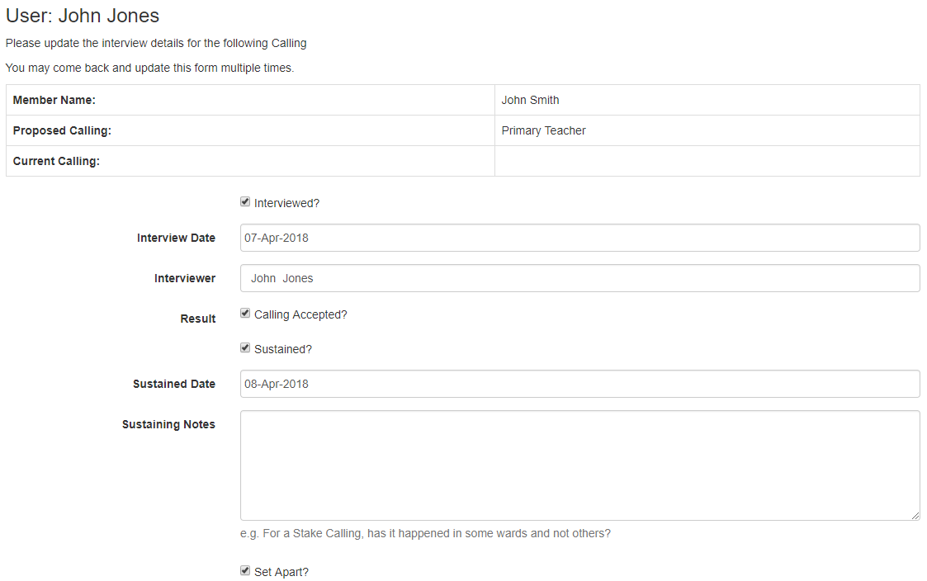
Managing Callings
The person that receives the assignment can click on the link in the email to complete the process.

Slide 16
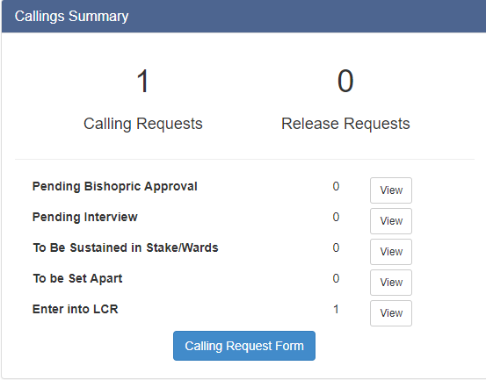
Managing Callings
After you select “view” from the dashboard, select “Manage” to continue the process until the calling has completed the entire process including the clerk entering the calling/release into “Leaders and Clerk Resources” (LCR) on lds.org.

Slide 17
Stake Calling Management

Slide 18
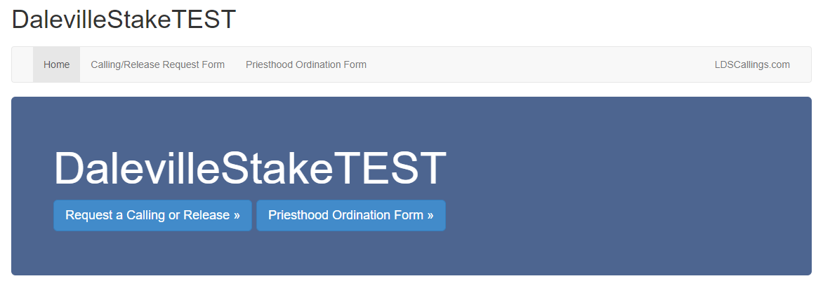
Managing Stake Callings
Wards and Branches can submit Callings/Priesthood Ordination requests to the Stake that need Stake Presidency approval.
A link can be provided to each Ward and Branch to submit recommendations to the Stake.
Example: https://dalevilletest.ldscallings.com/index.cfm

Slide 19
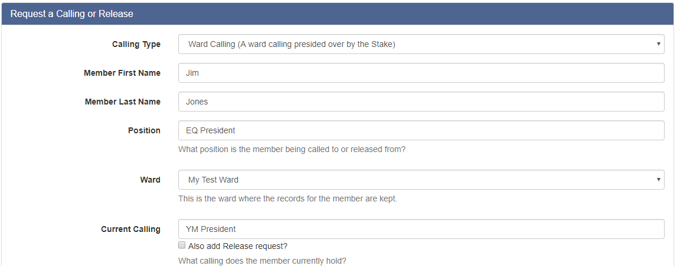
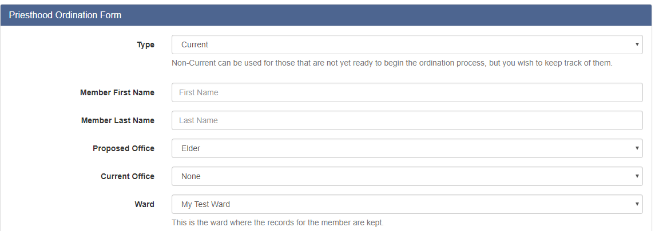
Managing Stake Callings

Slide 20
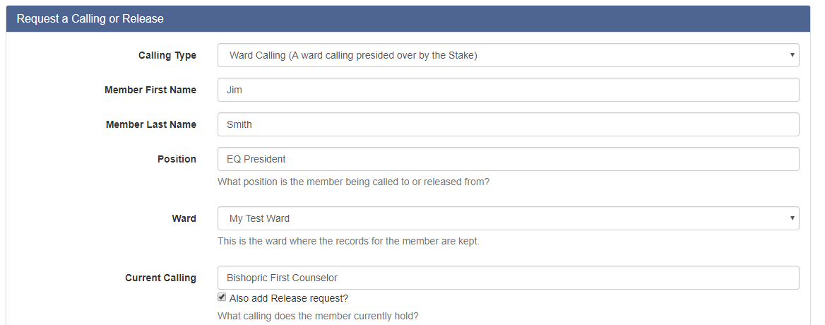
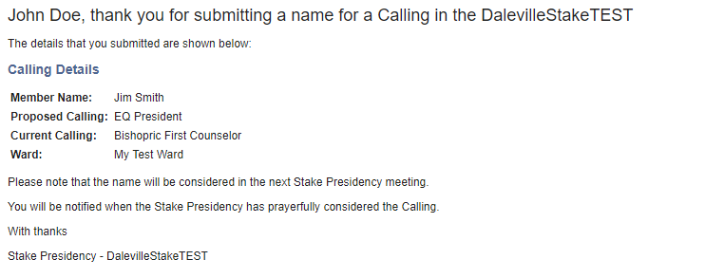
Managing Stake Callings
When a request is submitted to the Stake an email will be sent to the Stake Presidency.

Slide 21
Managing Stake Callings
The Stake Dashboard will be updated with the actions pending Stake Presidency Approval.

Slide 22
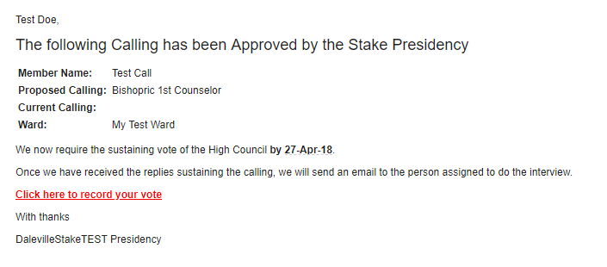
Managing Stake Callings
Once the Stake Presidency approves the recommendation an email will be sent to the High Council with a suspense to record their sustaining vote.

Slide 23
Managing Stake Callings
The High Counsel members will click on the link to record their vote .

Slide 24
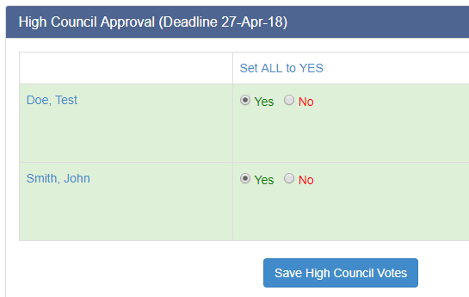
Managing Stake Callings
Once the High Counsel members have recorded their vote the ExSec or Clerk saves the HC Votes and the Stake Presidency saves the final approval and an email is automatically sent out to the person assigned to proceed with the interview.

Slide 25
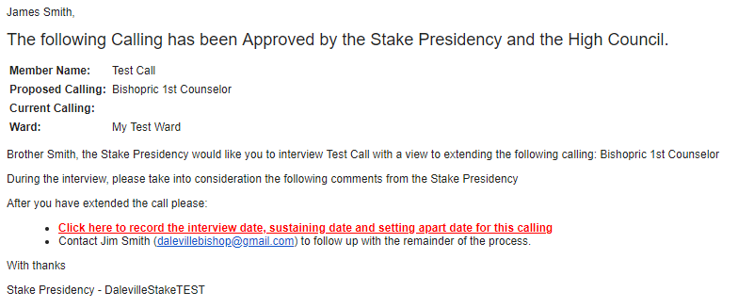
Managing Stake Callings
Once the High Counsel members have recorded their vote the ExSec or Clerk saves the HC Votes and the Stake Presidency saves the final approval and an email is automatically sent out to the person assigned to proceed with the interview.

Slide 26
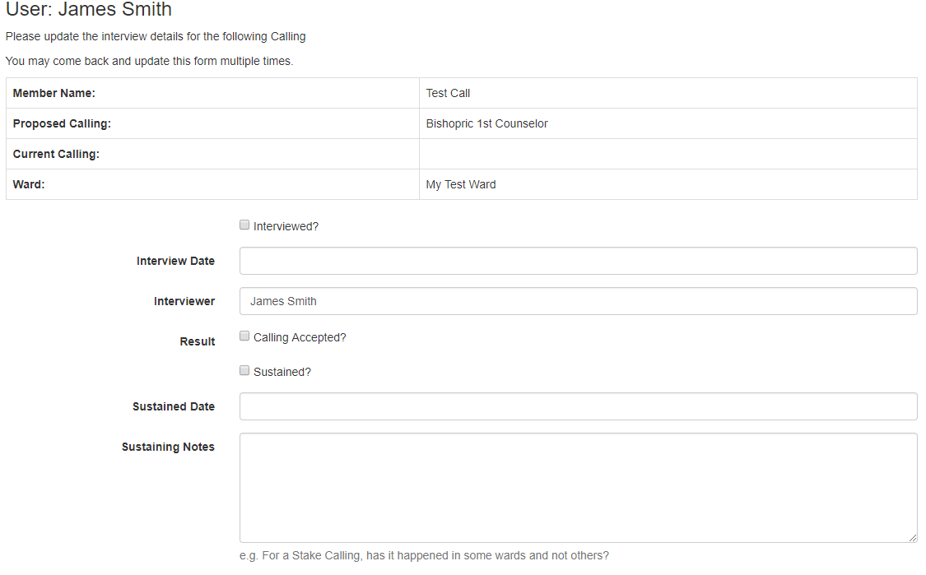

Slide 27
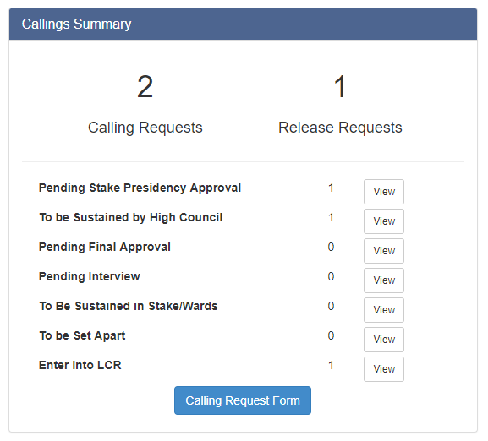
Managing Stake Callings
After all the actions have been completed the Stake Dashboard is updated and the clerk enters the data into LCR on lds.org.

